Slide 1
Mouse Cursor Control using Eye Movements
GUIDE:
Mr. Pugazhendhi Vasudevan M.E. (CSE)
TEAM LEADER-
G.KAVIYA-812619104012
TEAM MEMBER-
USHA KUMARI-812619104041

Slide 2
ABSTRACT
This paper presents a novel algorithm for
controlling the movement of a computer screen cursor using the
iris movement. By accurately detecting the position of the iris in
the eye and mapping that to a specific position on the computer
screen, the algorithm enables physically disabled individuals to
control the computer cursor movement to the left, right, up and
down. The algorithm also enables the person to open and close
folders or files or applications through a clicking mechanism.
This can be used to control the cursor on the screen using webcam and implemented using Python.

Slide 3
INTRODUCTION
Personal computers were initially used for solving
mathematical problems and word processing. In recent years,
however, computers have become necessary for every aspect of
our daily activities. These activities range from professional
applications to personal uses such as internet browsing,
shopping, socializing and entertainment.
The method described in this paper is distinctive because
unlike existing methods we did not use electrodes, infrared, or
any other light source to track the eyes. The only hardware that
is required is a PC or laptop along with a webcam, which
makes it practical and feasible.

Slide 4
DOMAIN-DEEP LEARNING
Deep learning (DL), a branch of machine learning (ML) and artificial intelligence (AI) is nowadays considered as a core technology of today’s Fourth Industrial Revolution .Due to its learning capabilities from data, DL technology originated from artificial neural network (ANN), has become a hot topic in the context of computing, and is widely applied in various application areas like healthcare, visual recognition, text analytics, cybersecurity, and many more. However, building an appropriate DL model is a challenging task, due to the dynamic nature and variations in real-world problems and data. Moreover, the lack of core understanding turns DL methods into black-box machines that hamper development at the standard level. This article presents a structured and comprehensive view on DL techniques including a taxonomy considering various types of real-world tasks like supervised or unsupervised

Slide 5
PROPOSED SYSTEM
In this paper, we have described a system that has facial tracking, detection of face, detection of eye and continuous eye blinks for controlling a nonintrusive human computer interface.
The mouse cursor is controlled by head movement as moving face up, down, sidewise movements and mouse events such as right and left click are controlled through eye blinks and squinting using OpenCV.
This system is mainly for disabled people to have effective communication with the computer.
Human eye movement has been used in the place of the conventional mouse.
The main aim of this system is to help physically challenged and amputee people especially person who do not have their arms.

Slide 6
LITERATURE SURVEY
Virtual Mouse with RGB Colored Tapes
The aim of this research is to investigate a new approach for controlling the mouse movements using a real-time camera. Instead of changing or adding mouse parts, a method where access to the mouse/cursor by hand gestures with colored tapes can be enabled. It tries to use a camera and computer vision technologies such as gesture recognition and image segmentation to control mouse tasks with colored tapes and shows how it can perform all the mouse functions a current mouse device can. In the first phase, hand gestures are acquired using a camera based on colour detection technique using segmentation and image subtraction algorithm.In the second phase, RGB colored tapes are used to control different functions of the mouse and also the combination of these 3 colors by considering the area of each object/colored tape using the blob analysis and the bounding box algorithm. The user must wear the red, green and blue tapes to the fingers such that it is easy to make the movements for each tape and also the combination of the colored tapes to acquire the desired output of the cursor movement in the system.

Slide 7
ADVANTAGES
System will avoid COVID-19 spread by eliminating the human intervention and dependency of devices to control the computer.
RGB colored tapes are used to control different functions of the mouse
DISADVANTAGE
The web camera captures the video at a fixed frame rate .
The camera captures an image, it is an inverted one.
The coordinates get confused if there is any other RGB color present in the camera fixed frame.
the presence of other color objects in the background may cause the system to give faulty response.

Slide 8
2) AI Virtual Mouse Using Hand Gesture Recognition
In this project, the person sitting in front of the webcam can give inputs using hand movement and the keyboard will work based on input gestures. Various functions can be performed such as, to swipe in right direction or left direction, alphabet can be selected using one finger gesture. Similarly, mouse can be controlled by eye movements and can perform right click and left click using eye movement, cursor can be control. This project will have virtual mouse and keyboard without any requirement of actual hardware mouse and keyboard, only webcam will be the hardware aspect. In this project we have done coding in Python using Anaconda framework. The webcam will be able to read the gestures of the user and will perform the operations for virtual mouse and keyboard. The algorithm use in project is Haar cascade, which helps to detect object in images

Slide 9
ADVANTAGES
Provides 99% accurate results compared to other techniques.
Image processing operations such as capturing image, removing noise, background subtraction, and edge detection.
DISADVANTAGE
Difficulties in clicking and dragging to select the text.
Small decrease in accuracy in right click mouse function
Depend upon lighting condition in the environment

Slide 10
3) Real-time virtual mouse system using system using RGB-D images fingertip detection
In this work, we propose a novel virtual mouse method using RGB-D images and fingertip detection. The hand region of interest and the center of the palm are first extracted using in-depth skeleton-joint information images from a Microsoft Kinect Sensor version 2, and then converted into a binary image. Then, the contours of the hands are extracted and described by a border-tracing algorithm. The Kcosine algorithm is used to detect the fingertip location, based on the hand-contour coordinates. Finally, the fingertip location is mapped to RGB images to control the mouse cursor based on a virtual screen. The system tracks fingertips in real-time at 30 FPS on a desktop computer using a single CPU and Kinect V2. The experimental results showed a high accuracy level; the system can work well in real-world environments with a single CPU. This fingertip-gesture-based interface allows humans to easily interact with computers by hand.

Slide 11
ADVANTAGES
Provides information about person’s view when moving over a wide area.
The rate of the considered devices ranges
from 30 Hz to 400 Hz. Devices with high sampling fre-
quency can record up to respectively 400 Hz and 250 Hz,
thus allowing the measurement of faster eye movement
DISADVANTAGE
The devices can track the eye using several cameras and multiple corneal reﬂections per eye.
The eye gaze tracking devices usually have a smaller ﬁeld of view within which the gaze point can be resolved. Thus, this feature can aﬀect the usability of the device in speciﬁc use case

Slide 12
4) Hand Gesture Recognition System as Virtual Mouse for HCI (GLOVE)
The mouse is one of the invention in HCI (human computer interaction) technology. Though wireless are Bluetooth mouse technology is invented still, that technology is not completely device free. A Bluetooth mouse has the requirement of battery power it requires extra power supply. Presence of extra devices in a mouse increases the difficulty level of more hardware components. The proposed mouse system is outside this limitation. This paper proposes a virtual mouse system using colored hand glove based on HCI using computer vision and hand gestures. Gestures captured with a webcam on processed with color segmentation, detection technique and feature extraction. The user will be allowed to control some of the computer cursor functions with a colored glove on the hand. Primarily, a user can perform with their fingers, scrolling up or down using their hands in different gestures. This system captures frames using a webcam or built-in cam it is based on the camera quality. So the usage of colored glove mouse system eliminates device dependency in order to use a mouse.

Slide 13
Advantages:
1.Able to recognize RGB movements, combinations, and translate actual mouse functions
to perform operations.
2.Cverrules the touch technology.
3.Cheapest system which works fine in a
standardized operating system and easy to use.
Disadvantages:
1.Captures images in regular time interval.
2.Algorithm used may or may not work in all environment.
3.Does not support on low camera quality.

Slide 14
Literature Survey COMPARISION
Title | Year | Author | Alogorithm | Detection techniques | Detecting range
Virtual Mouse with RGB Colored Tapes | 2016 | N. Scott, C. Green, and S. Fairley. | bounding box algorithm. | RGB colored tapes. | 1metre
2) AI Virtual Mouse Using Hand Gesture Recognition | 2022 | Joy Guha, Shreya Kumari | Machine learning alogorithm | Coordinates in hands. | 5metre

Slide 15
Literature Survey COMPARISION
Title | Year | Author | Algorithm | Detection techniques | Detecting range
3) Real-time virtual mouse system using system using RGB-D images fingertip detection | 2021 | Dinh-Son Tran | K-cosine algorithm | MediaPipe | 4metre
4) Hand Gesture Recognition System as Virtual Mouse for HCI (GLOVE) | 2021 | Venkateshwar A, Maheshwari Prakash Bhairawadag, Pavan Kumar P, Goutham U, Kalyan Kumar P | machine learning algorithm. | Colored gloves | 5metre

Slide 16
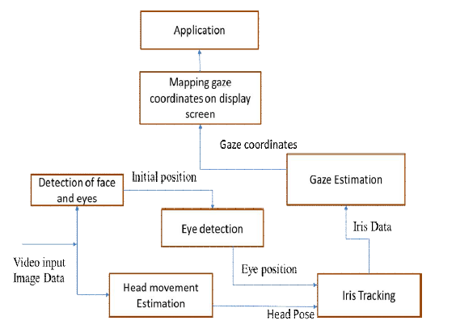
ARCHITECTURAL DESIGN

Slide 17
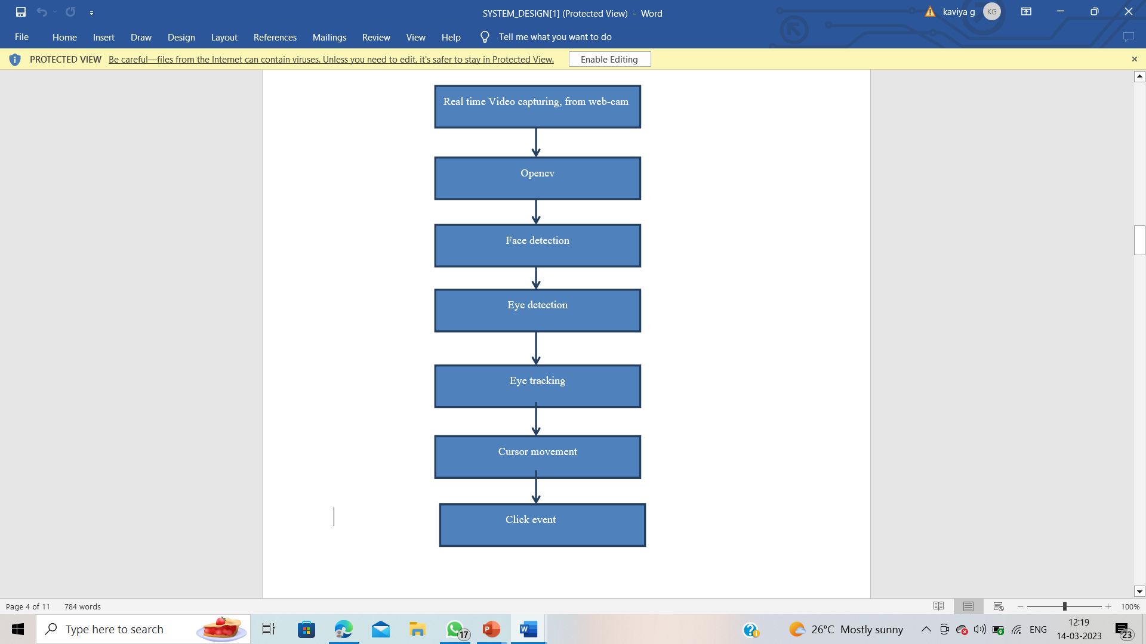
ALGORITHM-OPENCV

Slide 18
TOOLS USED
HARDWARE REQUIREMENT
System : Pentium i3 Processor.
Hard Disk : 500 GB.
Monitor : 15’’ LED
Input Devices : Keyboard, Mouse
Ram : 4 GB
SOFTWARE REQUIREMENTS
Operating system : Windows 10.
Coding Language : Python

Slide 19
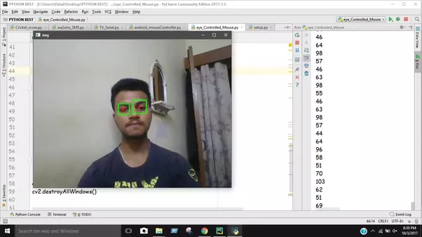
EXPECTED OUTCOMES

Slide 20
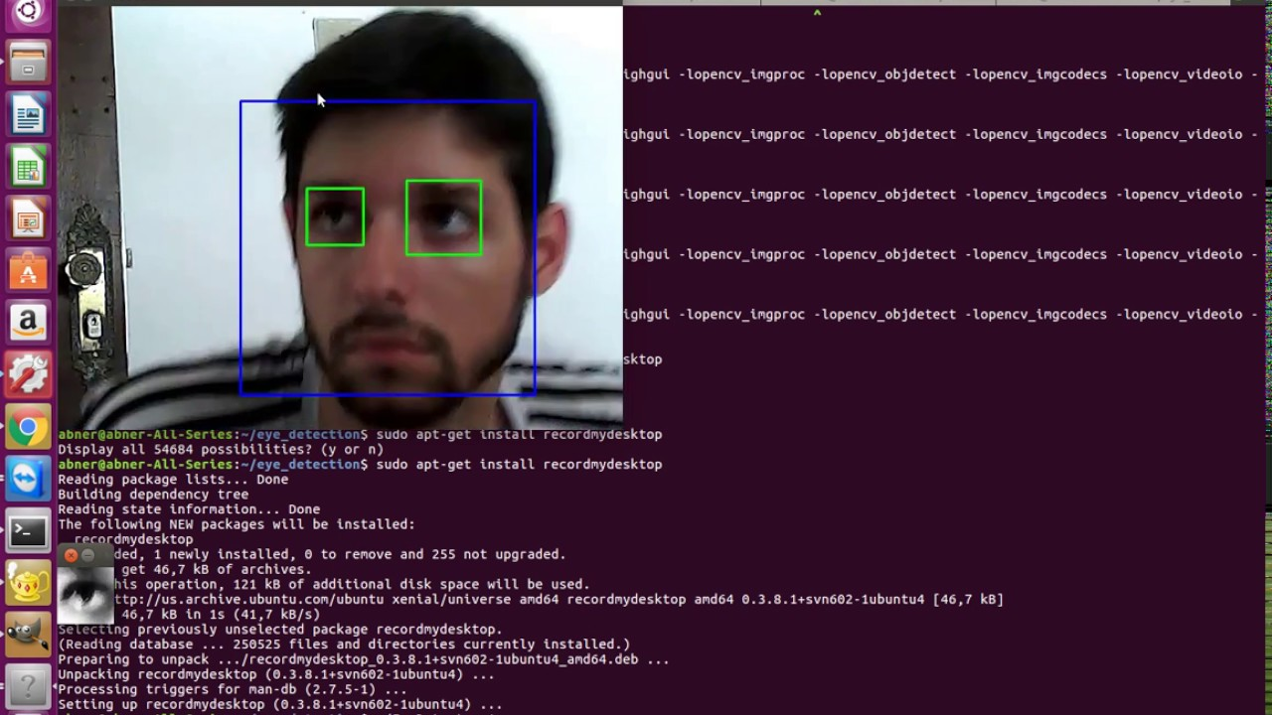

Slide 21
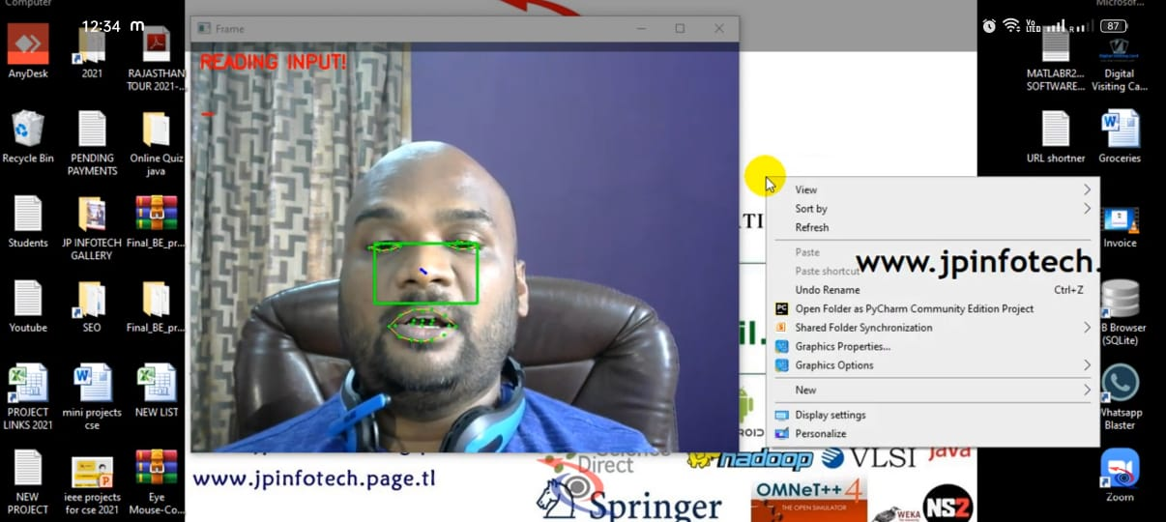

Slide 22
REFERENCES
(PDF) Eye-controlled mouse cursor for physically disabled individual (researchgate.net)
cursor-control/Cuursor Movement.doc at master · SaquibAnwar/cursor-control · GitHub
GitHub - acl21/Mouse_Cursor_Control_Handsfree: This HCI (Human-Computer Interaction) application in Python(3.6) will allow you to control your mouse cursor with your facial movements, works with just your regular webcam. Its hands-free, no wearable hardware or sensors needed.
Mouse Cursor Control using Eye Movements - JP INFOTECH

Slide 23
THANK YOU

